Slide 1
Abstraction, inheritance, interfaces, Polymorphism

Slide 2
Content
Interfaces
Abstract class
Abstract methods
Accessibility of class members
Inheritance
Interface vs abstract class
Overriding method
Overriding vs overloading
Polymorphism
Lambda expressions
Facts about the quiz

Slide 3
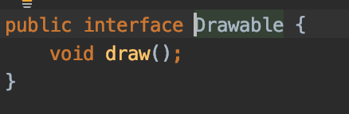
Interfaces
A reference type
All methods declared in an interface are by default abstract (only method signature, no body)
Could have variables which are static, public and final by default
Interfaces cannot be instantiated directly
Syntax - declare interface via the key word interface
public interface MyInterfaceName {
public void myMethodInInterface();
// .. any more methods }

Slide 4
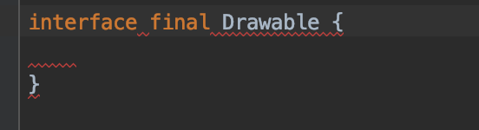
Interfaces
Interface is not required to have any method
Interface can not be final
Compilation error - we cant make interface final

Slide 5
Interfaces
Interfaces and classes
A class can implement one or many interfaces
Then all methods from the interface should be implemented in the class
Syntax via usage of the key word implements
public class MyClass implements Interface1 {
// implementing all methods from the implemented inerface1
}
public class MyClass implements Interface1, Interface2 {
// implementing all methods from the implemented interfae1, interface2
}

Slide 6
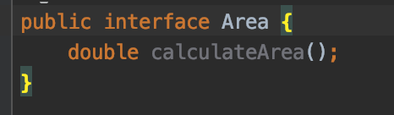
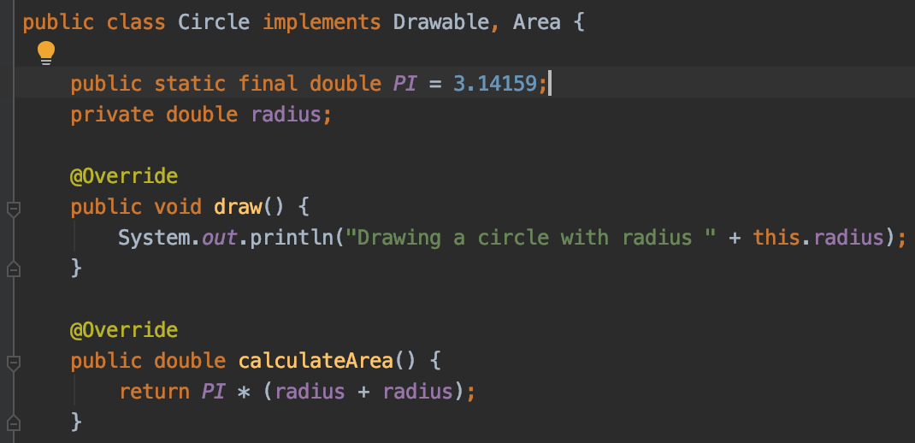
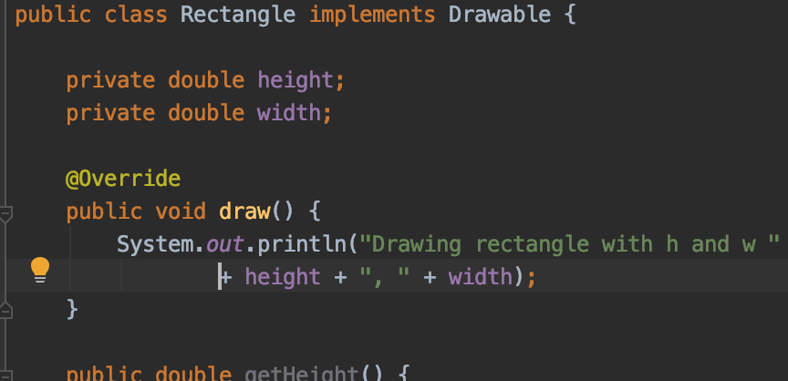
Interfaces
- When a class implements an or many interfaces,
then all methods declared in these interfaces are implemented

Slide 7
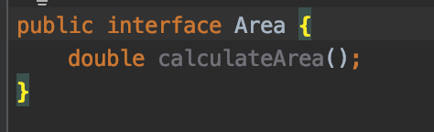
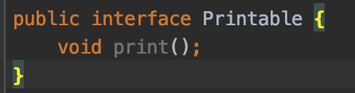
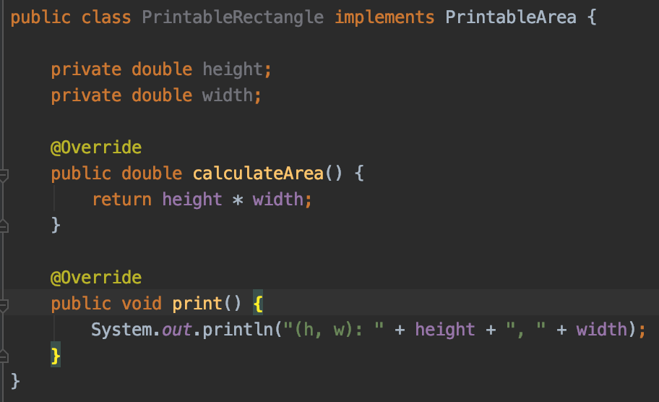
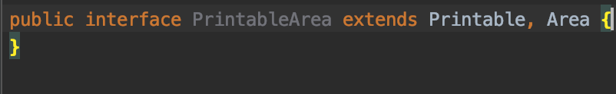
Interfaces
An interface can extends one or many interfaces
Then the extendable interface has all the methods from the parent interfaces and the class implements the extendable interface must implement all these methods

Slide 8
Interfaces
Fact about interfaces and usage by classes
You cannot instantiate an interface
There are not any instance variables (only public static final)
All methods are abstract
An interface is NOT extended by class, it is implemented by class (Why?)
An interface can extends multiple interfaces
Implements is the key word for a class to implement interfaces
Interface CAN NOT be declared as private, protected or transient
Interface variables must be initialized at the time of declaration otherwise compiler will throw an error:
public interface ErrorInterface {
int x; //Compile-time error
}

Slide 9
Interfaces
Fact about interfaces and usage by classes
A class cannot implement two interfaces that have methods with same name and arguments, but different return types
interface A {
public void method();
}
interface B {
public int method();
}
class C implements A,B {
public void method() // error { }
public int method() // error { }
}

Slide 10
Interfaces
Demo time –> java_inheritance_abstract_demos_6 -> interfaces

Slide 11
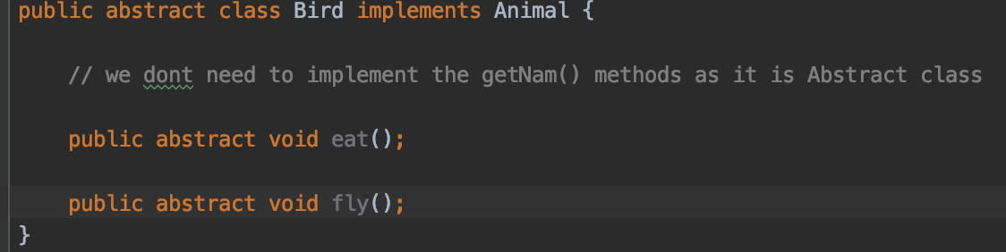
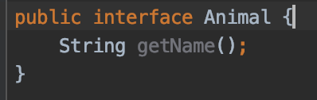
Abstract class
A java class containing abstract key word in its declaration
May or may not Contains abstract methods (methods without body)
If a class contains at least one abstract method, then it must be declared abstract
If a class is declared abstract, it can not be initialized // Why?
public abstract A {}
A a = new A(); // error
Abstract class can implement interface, leaving the methods from the interface not implemented (as abstract class could not has methods with body)

Slide 12
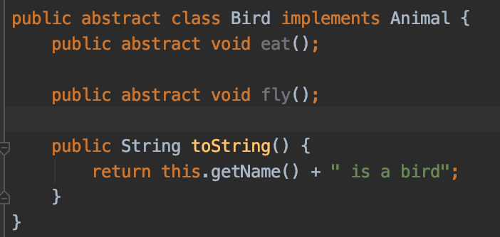
Abstract class
Concrete classes could extends abstract class, but then the class must implement the abstract methods
Abstract class could extend abstract class
An abstract class has no use until unless it is extended by some other class
If you declare an abstract method in a class then you must declare the class abstract as well
if a class has an abstract method it should be declared abstract
It can have non-abstract method (concrete methods) as well:

Slide 13
Abstract methods
Methods without body is abstract methods
Abstract methods are declared via the key word abstract
public abstract int myMethod(String arg);
Abstract methods has only signature
Abstract methods maybe defined only in abstract class
Abstract methods may be not declared as private or final

Slide 14
Abstract class
Demo -> –> java_inheritance_abstract_demos_6 -> abstraction

Slide 15
Accessibility of class members
There are next types of controlling of access for methods and class field in java
public: expose the members (fields and methods) to everywhere. All other classes could use them
protected: restricted only to sub classes and to the same package. Only sub classes and classes in same package can access the protected fields or protected methods
packaged (or no modifier): all the classes in the same package level
private: fields and methods are accessed inside the class only

Slide 16
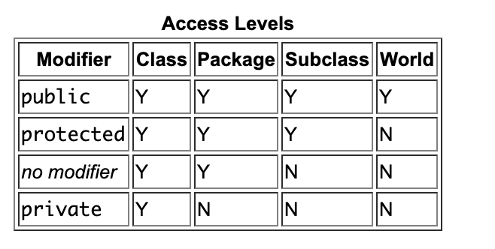
Accessibility of class members
source: https://docs.oracle.com/javase/tutorial/java/javaOO/accesscontrol.html

Slide 17
Accessibility of class members
Pay attention in the exams with tricky questions like:
package bg.newhorizons.af;
public class A {
public int i1 = 1;
protected int i2 = 2;
}
//B.java
import bg.newhorizons.af.A;
public class B extends A {
public void print() {
A obj = new A();
System.out.println(obj.i1); //Line 8
System.out.println(obj.i2); //Line 9 // i2 has protected access, no not visible in other packages
System.out.println(this.i2); //Line 10
System.out.println(super.i2); //Line 11
}
}

Slide 18
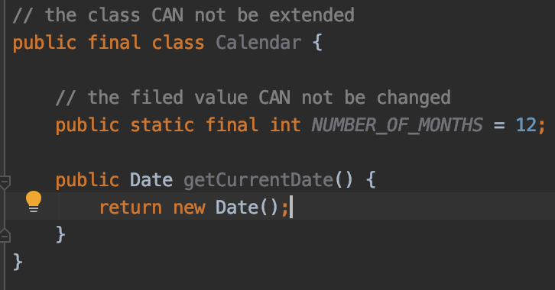
Accessibility of class members
Non-Access Modifiers
For class
final :if a class is declared as final, NO other class can extend it
abstract: the class CAN not be used to crate objects
For attributes and methods
final: attributes and methods cannot be overridden/modified
static: attributes and methods belongs to the class, rather than an object
abstract: can be used only in
abstract class and only in methods.
The method doe not have a body

Slide 19
Inheritance
A possibility a class to inherits members and methods from another class
Syntax
class Super {
……
}
class Sub extends Super {
……
}

Slide 20
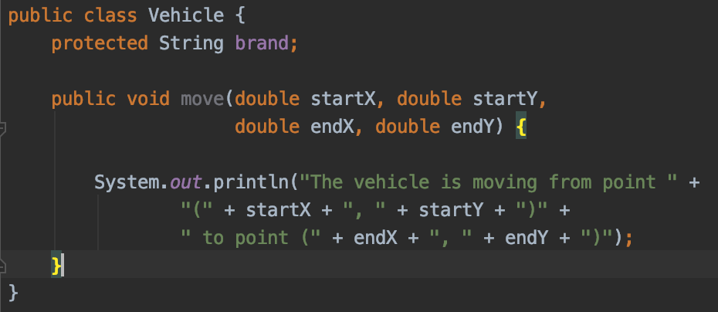
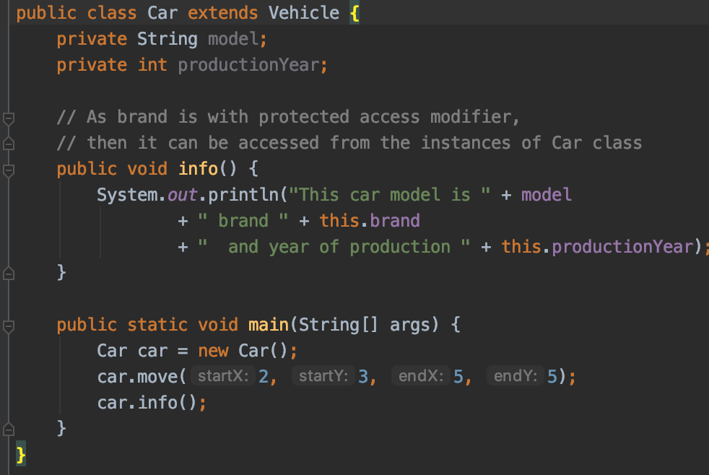
Inheritance

Slide 21
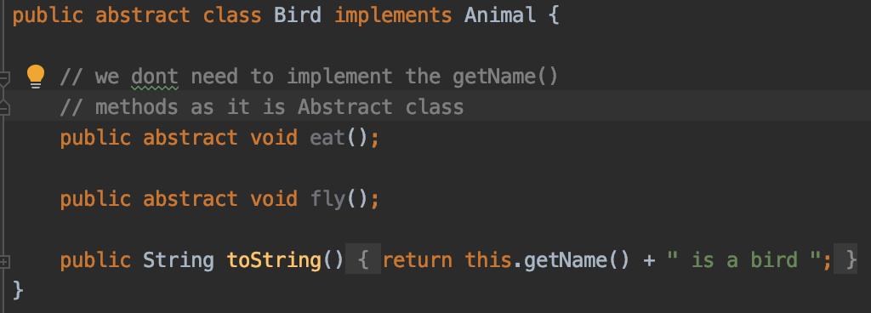
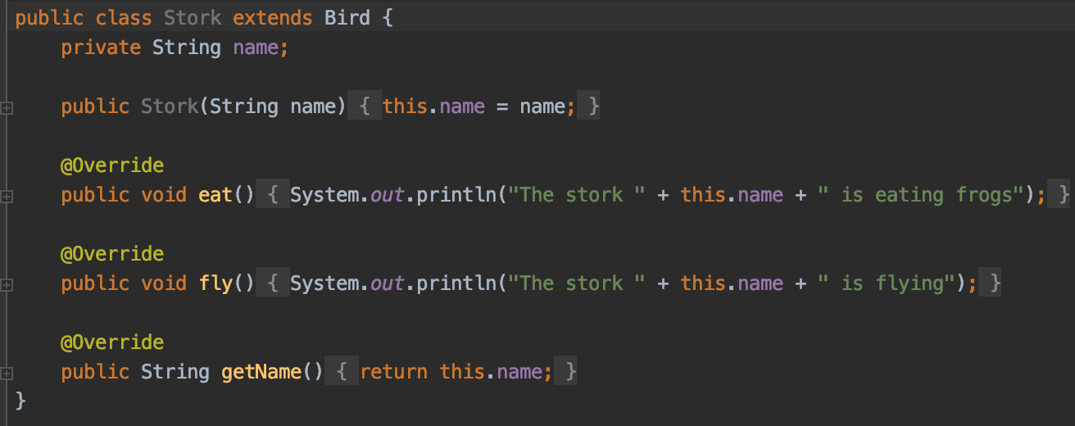
Inheritance
You can have a construction in an abstract class. In this case any sub class, concrete class, should call the constructor

Slide 22
Inheritance
Subclass: class which inherits methods and values from the superclass
Superclass: the class from which the child class inherits all the methods and values
“is-a” relationship: gets implemented by inheritance – means a class is part of the parent class (Stock is a Bird)
“has-a” relationship: class has a reference to another class.
Classes could have only single inheritance
Interfaces could have multiple inheritance
Multilevel inheritance: A extends B and C extends B

Slide 23
Inheritance
super(…) key word is used to call a constructor of sub class
Always super() should be called first in the contractor
public class Vehicle { int doors;
public Vehicle(int doors) {
this.doors = doors;
}
}
public class Car extends Vehicle { public Car() {
super(0);
} public Car(int doors) {
super(doors);
}
}

Slide 24
Inheritance
public class Vehicle { int doors;
public Vehicle(int doors) {
this.doors = doors;
}
}
public class Car extends Vehicle { public Car() { } // Compilation error }

Slide 25
Inheritance
Constructing rules:
this(..) should be first if there is no super() call, if there is a call to a constructor in super class – then call super() comes first
If no super(). Is used java will call the no-arg super class constructor
If parent class does not no-arg constructor and the child class do not call any constructor, then compilation error will occur
If parent does not have no-arg constructor, thenthe child class should call explicitly the constructor of the parent class

Slide 26
Interface vs abstract class
 | Type of methods | Variables | Type of variables | Multiple implementation | Members accessibility
Interface | Only abstract methods | Variables are by default final | Only static and final variables | Extends only interfaces | All members are public
Abstract class | Abstract and non abstract methods | May contain non-final variables | Can have final, non final, static and non static | Extends interfaces and another classes | Could have private protected, public and etc … members

Slide 27
Inheritance
Demo -> java_inheritance_abstract_demos_6 -> inheritance

Slide 28
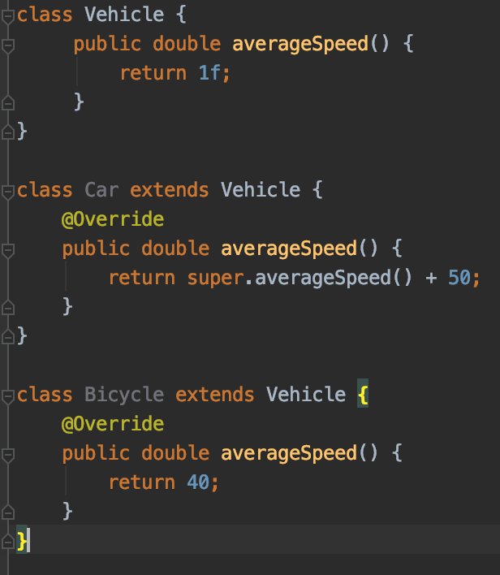
Overriding method
A method in the parent class with same signature and return type
Same list of the arguments
Return type should be the same or a subtype of the return type declared in the original overridden method in the super class

Slide 29
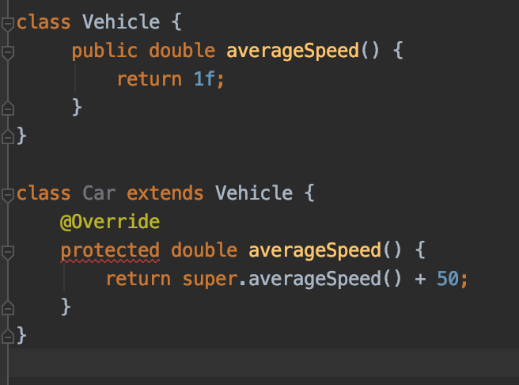
Overriding method
The access level cannot be more restrictive than the overridden method’s access level
The access level can be same or wider than the overridden method’s access level
In the parent class we do have public, so it can not be protected or private or package in child class

Slide 30
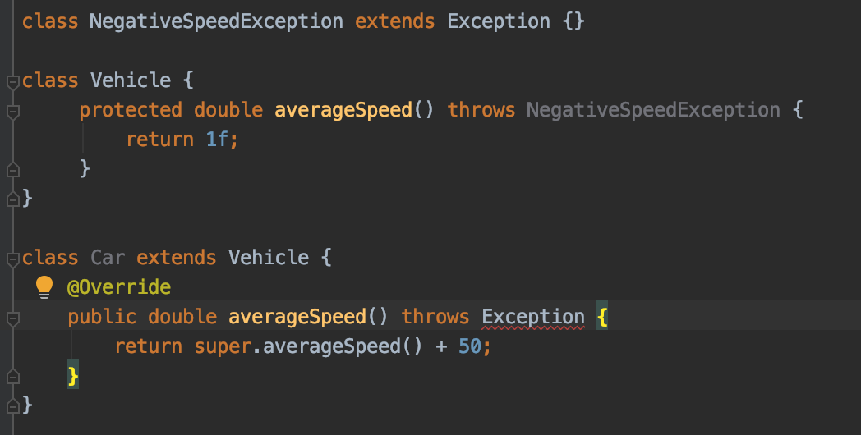
Overriding method
A method declared final cannot be overridden
Static cannot be overridden – why?
A method in a child class may not throw a checked exception that is new or broader than the class of any exception thrown in the parent class
Error – Exception is wider!

Slide 31
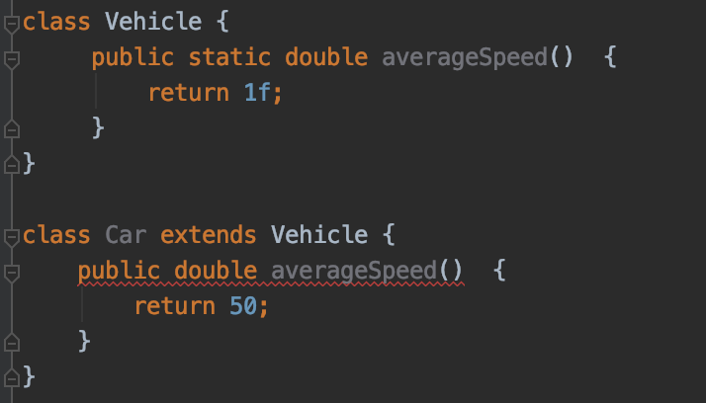
Overriding method
If a method can not be inherited, then it can not be overridden
A subclass within the same package as the instance’s superclass can override any superclass method that is not declared private or final – means public, protected or default package level
A subclass in a different package can only override the non-final methods declared public or protected
You cannot declare a method in child with same signature with a static method in parent class

Slide 32
Overriding vs overloading
Overriding:
Redefining the parent method in the child class
The name of the method is same
The child method has same arguments
Has same or a sub class of return type of the parent class method
It must not have a more restrictive access modifier
It must not throw new or broader checked exceptions
Runtime polymorphism
Overloading:
Redefining same method
On same class or sub class
Both must have same method name
Both must have different arguments lists

Slide 33
Polymorphism
Example from life:
A man can be many this at same time, depending on the context – a father, a husband, an employee
Same person, different behavioral in different situations
This is called polymorphism: perform single actions in different ways
Ability of an object to take on many forms: e.g. a parent class reference point to a child subclass object
Compiled type polymorphism: achieved by overloading of a method
Runtime or dynamic polymorphism: achieved by overriding of a method

Slide 34
Polymorphism
Demo -> java_inheritance_abstract_demos_6 -> Polymorphism

Slide 35
Lambda expressions
Introduced at java 8
Facilitates functional programming, and simplifies the development a lot
Syntax:
parameter -> expression body
Characteristics
Optional type declaration − No need to declare the type of a parameter. The compiler can inference the same from the value of the parameter.
Optional parenthesis around parameter − No need to declare a single parameter in parenthesis. For multiple parameters, parentheses are required.
Optional curly braces − No need to use curly braces in expression body if the body contains a single statement.
Optional return keyword − The compiler automatically returns the value if the body has a single expression to return the value. Curly braces are required to indicate that expression returns a value.

Slide 36
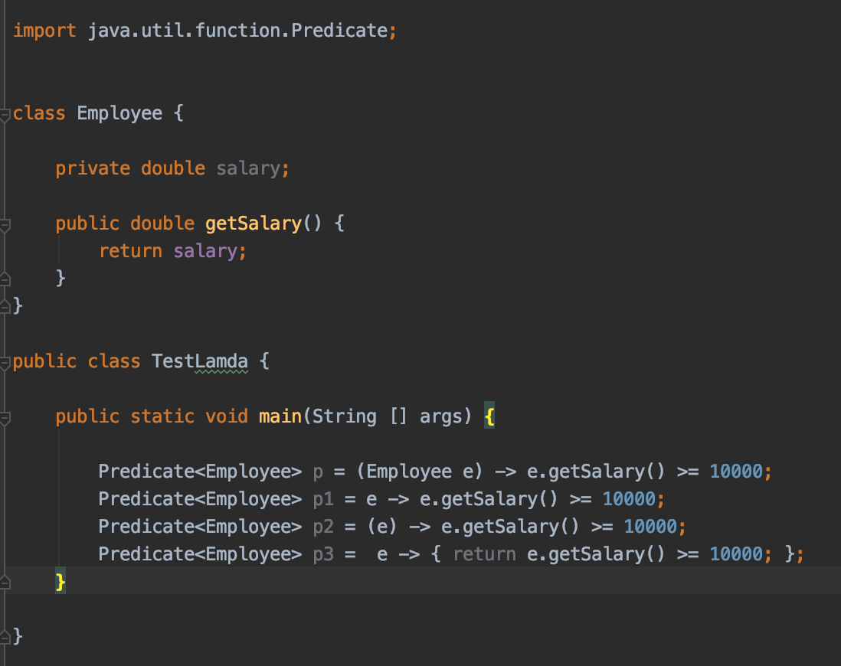
Lambda expressions

Slide 37
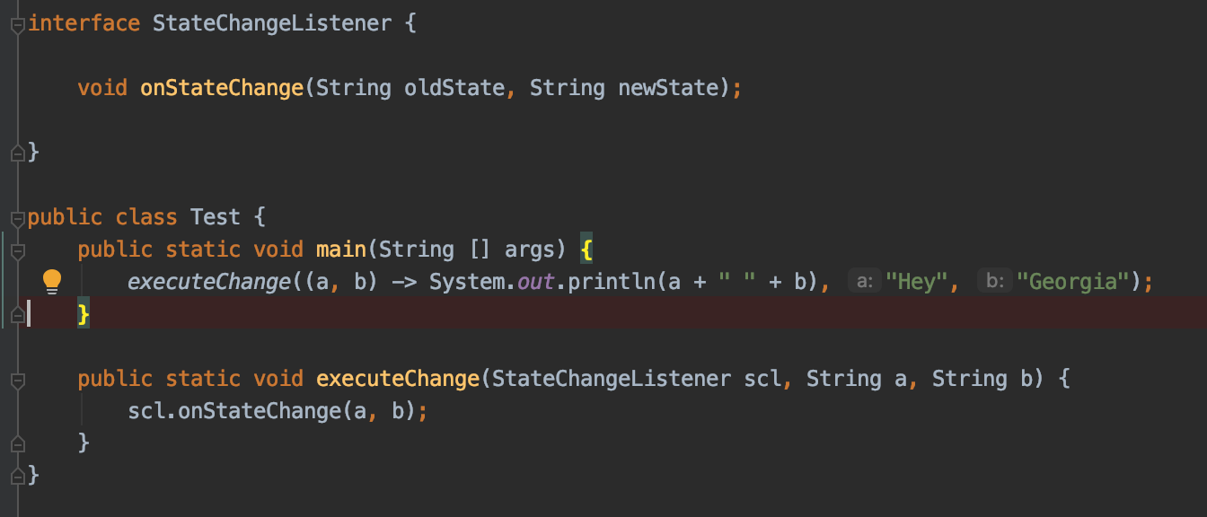
Lambda expressions
In. java 8 you can simplify the single method interface implementation via anonymous implementation:

Slide 38
Lambda expressions
Demos -> lamdaexpressions

Slide 39
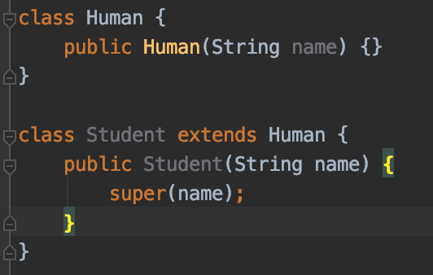
Fatcs about the quiz
An interface can extends one or many interfaces
All classes extends by default Object it it’s methods
Superclass can be only one!
Inheriting Constructors: A subclass inherits all the members (fields, methods, and nested classes) from its superclass. Constructor of the superclass can be invoked from the subclass
Use key word for calling super class constructor is super
Default call to the super constructor is for no args
constructor

Slide 40
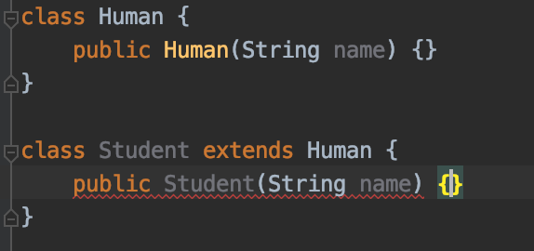
Fatcs about the quiz
Calling of super constructor from child class where we do not have default non-arg constructor is a must, otherwise compilation error will occur

Slide 41
Fatcs about the quiz
Super methods with same name are called via super key word again
Polymorphism could be achieved via assigning child based instances to a parent instance, so that at runtime we can change the behavioral of the members
We can write a new static method in the subclass that has the same signature as the one in the superclass, thus hiding it
The inherited fields can be used directly, just like any other field
You can have method with same class name
public void Student(String name) is a method, not constructor!

Slide 42
Fatcs about the quiz
Multiple inheritance could be achieved via interfaces
By default all methods in interfaces are public
By default all fields in interfaces are static, public and final
The access modifier of an overriding or hiding method must provide at least as much access as the overridden or hidden method, or a compile-time error occurs.
public class Human {
public void print() {}
}
public class Student extends Human {
protected void print() {} // compile error
}

Slide 43
Fatcs about the quiz
Flow of initialization and calls
Static blocks* of the superclass
Static blocks* of the class
Non-static blocks* of the superclass
Constructor of the superclass
Non-static blocks* of the class
Constructor of the class

Slide 44
Fatcs about the quiz
Ability to write code where you do extends other classes
Java class extends all public and protected variables and methods
The first line of every constructor is to call another constructor in the same class via this() or the constructor of super class via super()
Parent methods and variables can be accessed using the key word super
All classes in java directly extends java.lanf.Object or via superclass
Knowing overriding
Method should have same signature
Be at least as accessible as the parent method
Must not declare any new or broader exceptions
Must use same or subtype for the return

Slide 45
Fatcs about the quiz
Know about overriding vs overloading - same signature for both but different input parameters when we do have overloading
Abstract classes cannot be instantiated and require a concrete subclass to be accessed
Abstract classes can include any number, including zero, of abstract and nonabstract methods
The first concrete subclass of an abstract class must implement all the inherited methods
Abstract classes and methods may not be marked as final or private

Slide 46
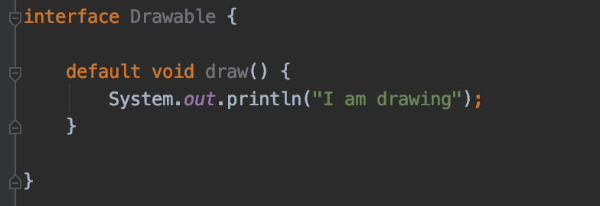
Fatcs about the quiz
Be able to write default methods in interfaces
Understand polymorphs
An object in Java may take on a variety of forms, in part depending on the reference used to access the object
It is common to rely on polymorphic parameter (the ability of methods to be automatically passed as a superclass or interface reference) when creating method definitions

Slide 47
Fatcs about the quiz
Understand casting
An instance could be cast to a superclass or interface without explicit casting
An explicit cast is required if the reference is being narrowed to a subclass of the object
Not related references casting is not allowed java

Slide 48
Questions?
Notes:
Do you have any questions?

Slide 49
Thank You For Your Time

